Slide 1
Defund the journals!
And fund repositories instead
Björn Brembs Universität Regensburg
http://brembs.net - @brembs

Slide 2

Reliability Affordability Functionality
The disaster that is scholarly information infrastructure

Slide 3
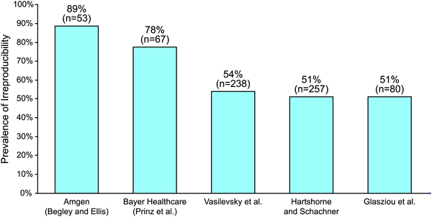
Irreproducibility
Open Science Collaboration
61%
(n=100)
Freedman LP, Cockburn IM, Simcoe TS (2015) http://journals.plos.org/plosbiology/article?id=info:doi/10.1371/journal.pbio.1002165

Slide 4
Social Sciences
Successful:
13/21: 62%
10.1038/s41562-018-0399-z

Slide 5
Economics
Successful:
11/18: 61%
10.1126/science.aaf0918

Slide 6
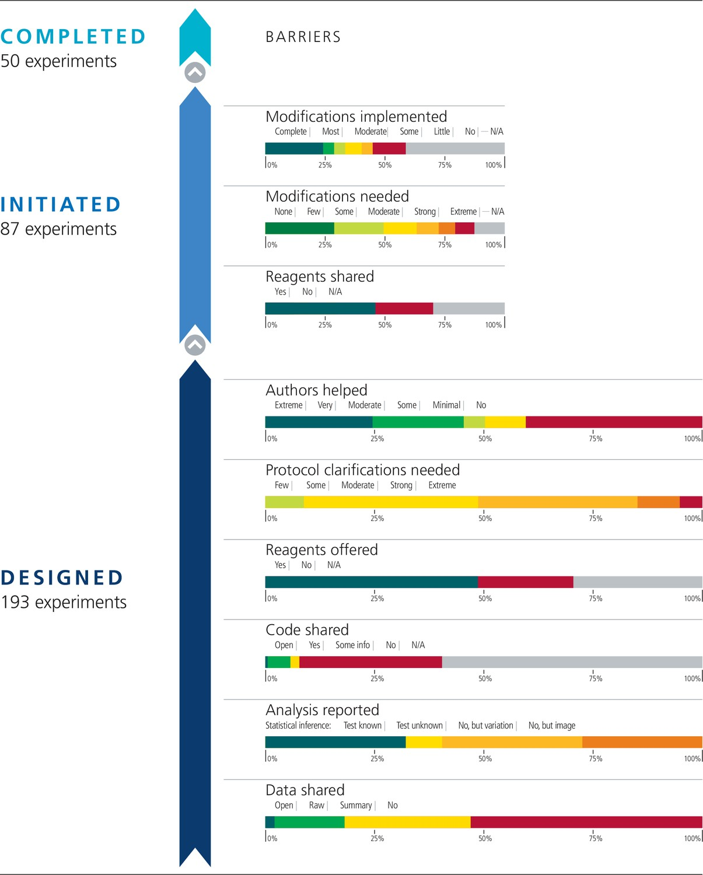
Cancer Research
 | Papers | Experiments | Effects | All outcomes
Total number | 23 | 50 | 158 | 188
“combining positive and null effects, the success rate was 46% (51/112)“

Slide 10

“high impact”
How reliable is the research in our most prestigious journals?

Slide 11
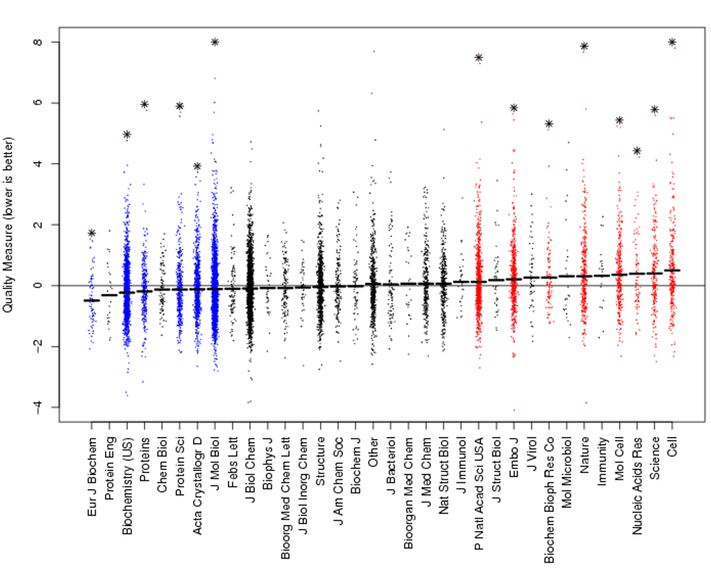
‘Quality’
10.1107/S0907444907033847

Slide 12
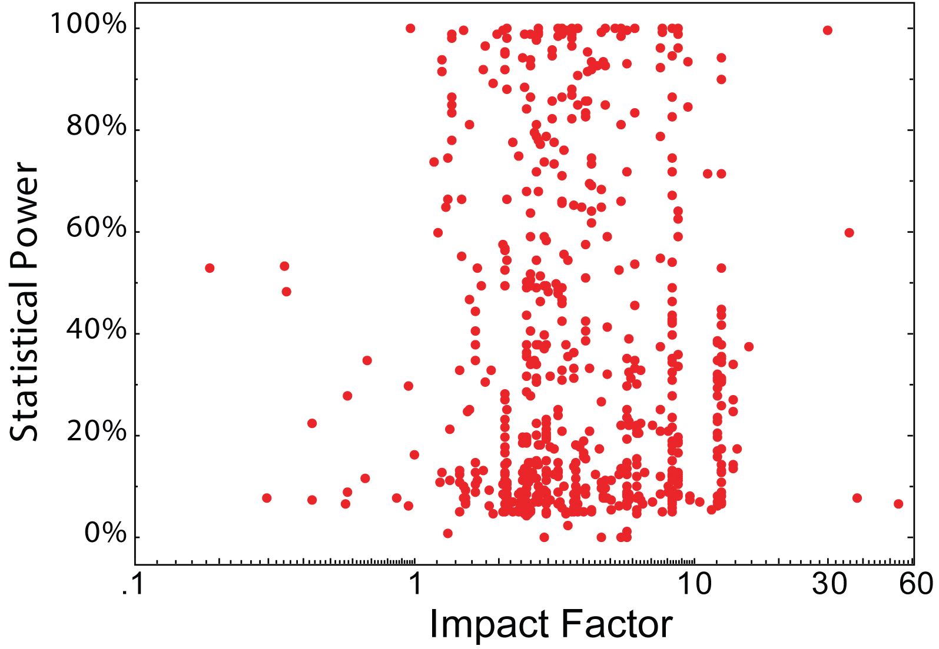
Methodology
Brembs, B., Button, K., & Munafò, M. (2013). Deep impact: unintended consequences of journal rank. Frontiers in Human Neuroscience, 7. doi:10.3389/fnhum.2013.00291

Slide 13
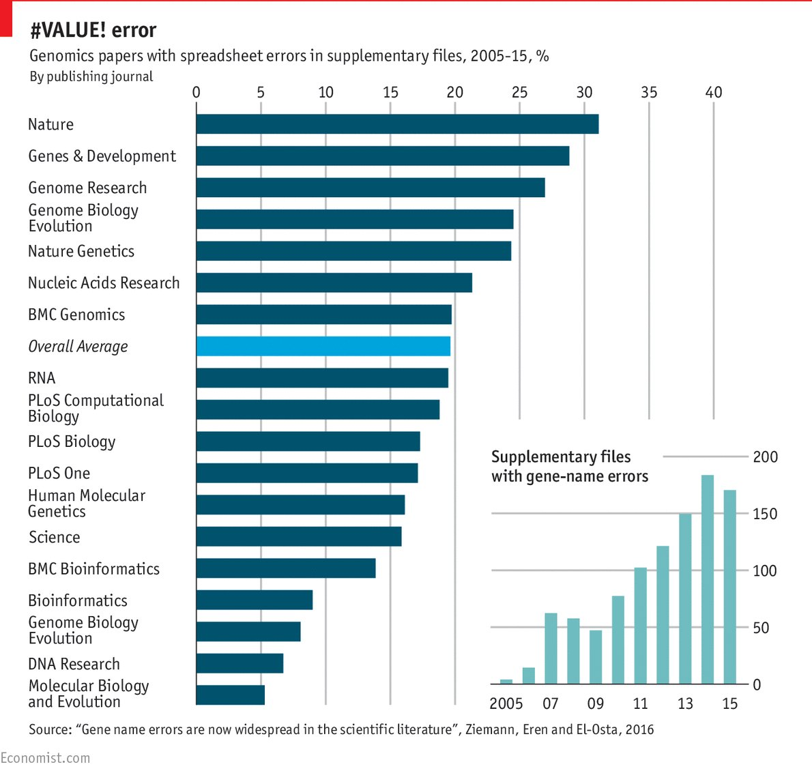
Errors
DOI: 10.1186/s13059-016-1044-7
And 10.1371/journal.pcbi.1008984
-omics studies

Slide 14
Quality?
“High-Impact” journals attract the most unreliable research

Slide 15
Reliability Affordability Functionality
The disaster that is scholarly information infrastructure

Slide 16

Nature APC
More than 10.000€ for one article

Slide 17






Actual Costs
Online submission | US$ 21.70
DOI | US$ 1.94
Plagiarism detection | US$ 0.95
Fundref | US$ 0.31
Bibliographic reference normalization | US$ 25.00
Production of XML, PDFWeb, PDF for Print and EPUB | US$ 100.00
indexing, online publication and interoperability | US$ 66.45
Kosten pro Artikel | US$ 216.35

Slide 18
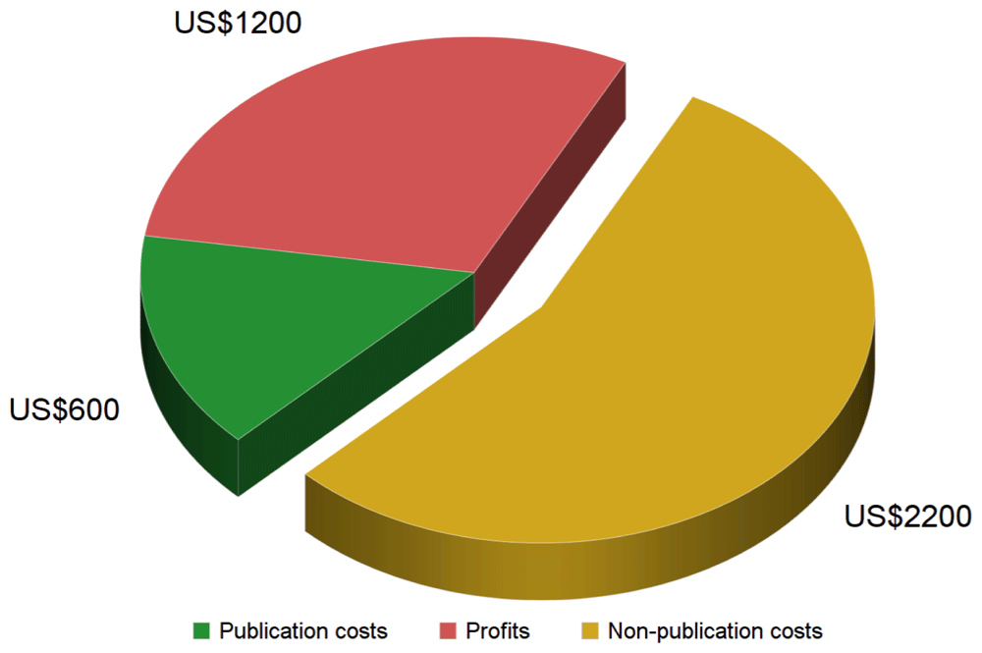
What to do with all that money?
10.12688/f1000research.27468.2

Slide 19
Invest in Quality Control?

Slide 20
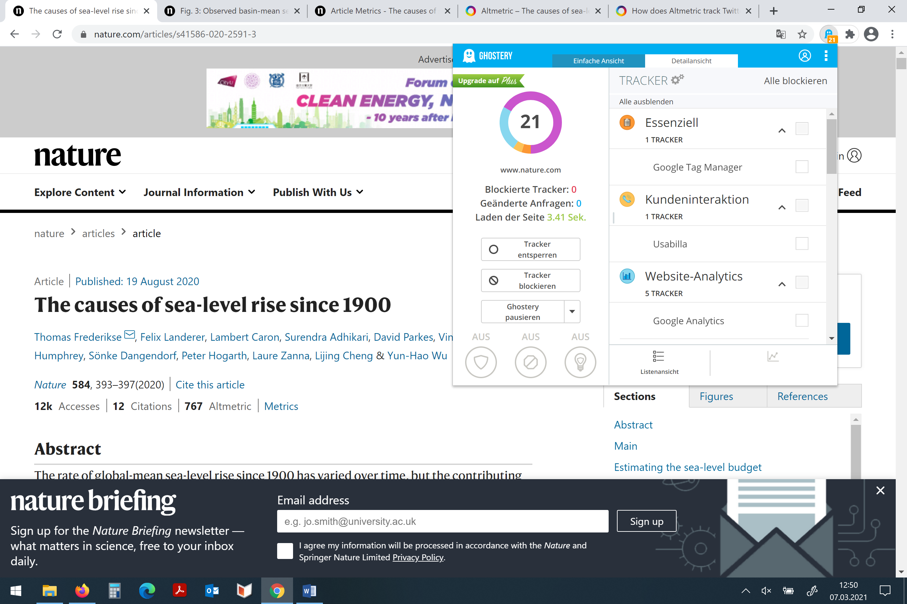
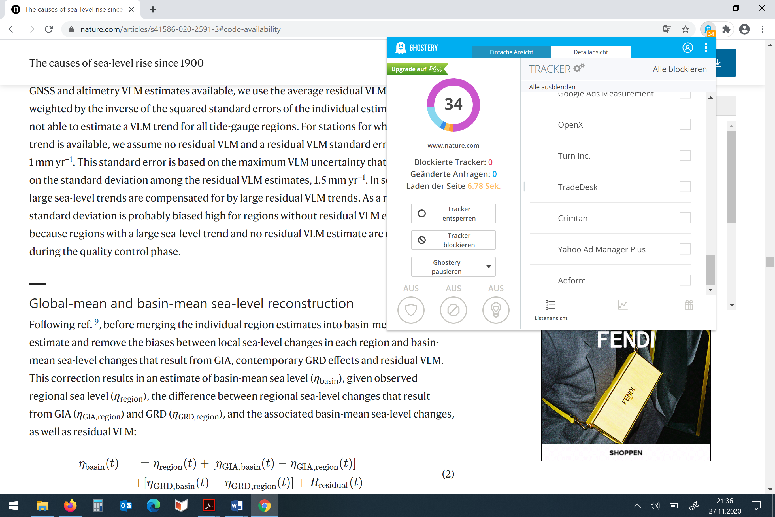
Journals that read you

Slide 21
Journals that read you
https://doi.org/10.3998/jep.1874

Slide 22
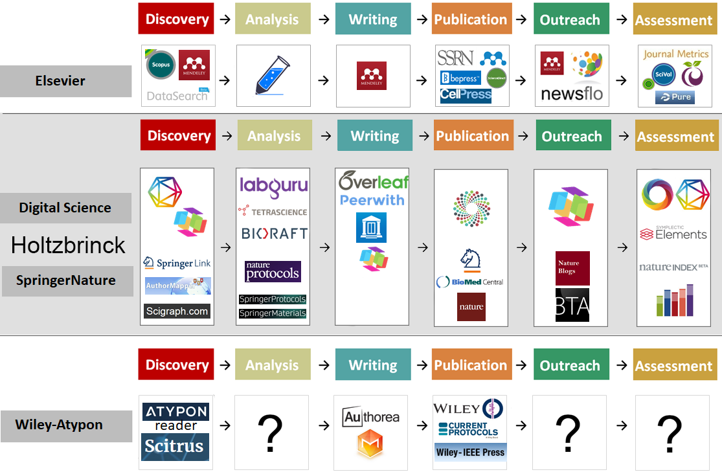
Expand Monopolies

Slide 23
Reverse the flow of information

Slide 24
Reliability Affordability Functionality
The disaster that is scholarly information infrastructure

Slide 25
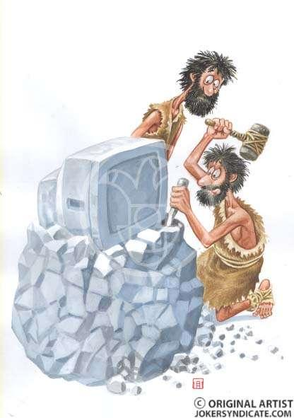
QC just one missing functionality
Obsolete modes of access
Journal prestige correlates with unreliability
No scientific impact analysis
Suboptimal peer-review
Massive transparency issues
No effective sort, filter and discover solution
No functional hyperlinks
Static data visualizations
No content mining
No social component
No global search
Hardly any user statistics
etc.
…it’s like the internet in 1995!

Slide 26

Not just papers
Scientists produce text, data and code

Slide 27
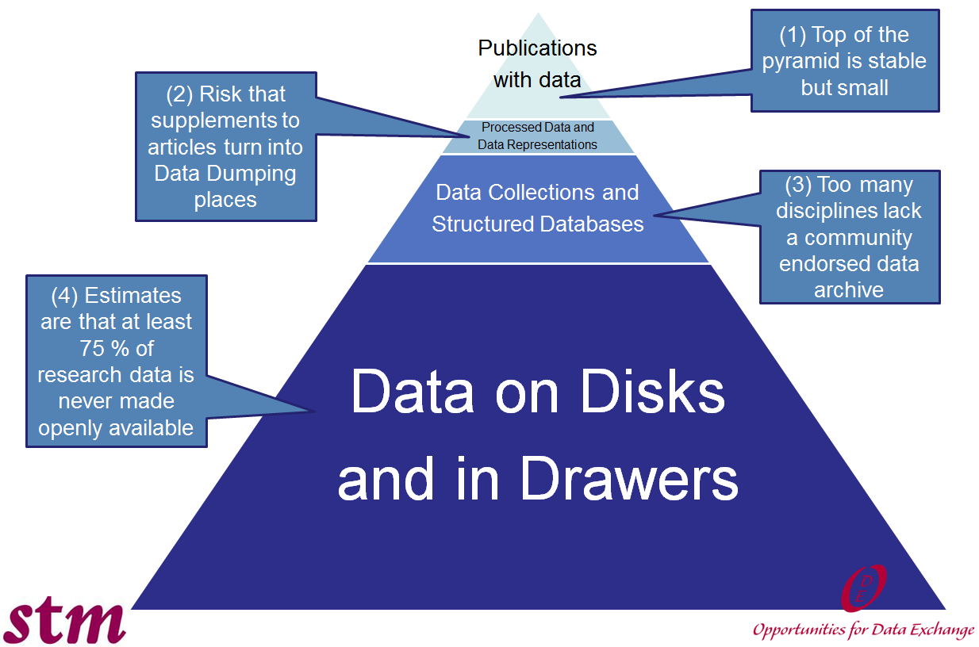
Data in peril
Report on Integration of Data and Publications, ODE Report 2011
http://www.alliancepermanentaccess.org/wp-content/plugins/download-monitor/download.php?id=ODE+Report+on+Integration+of+Data+and+Publications

Slide 28
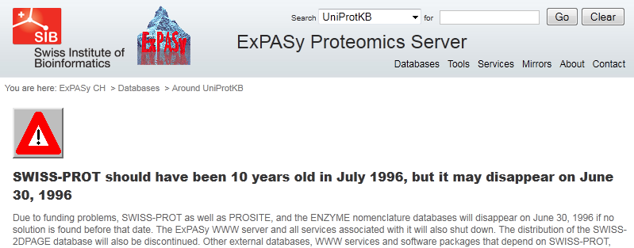

Slide 30
Data is disappearing

Slide 31
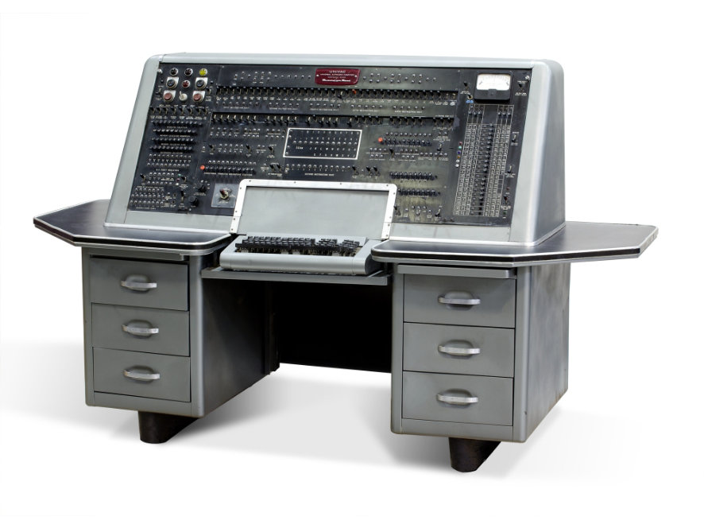
Non-existent software/code archives
UNIVAC (A-2) 1953: share and re-use code

Slide 32


Slide 34
Reliability Affordability Functionality
The disaster that is scholarly information infrastructure

Slide 35
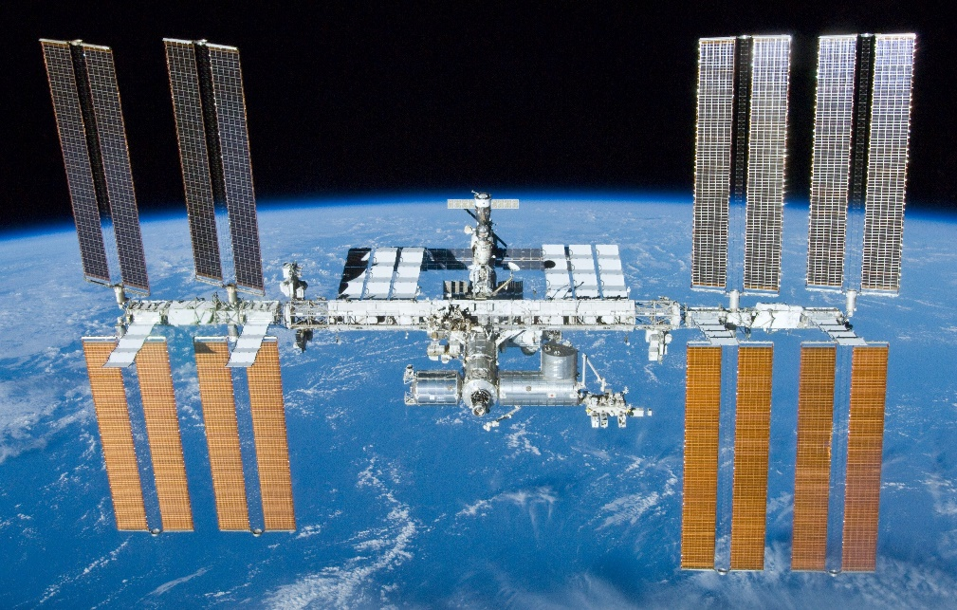
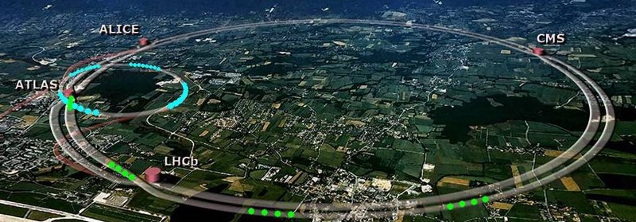
Tackle RAF root: stop paying for journals
tomorrow
today
~3 billion / year
Potential for reform: US$ 9.56 billion p.a.
~2 billion / year

Slide 36
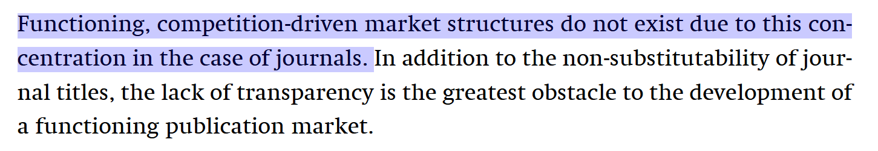
How to get there?

Slide 37
Incentives I: Procurement Rules
Current journal payments for content allowed only via “single source exemption”

Slide 38
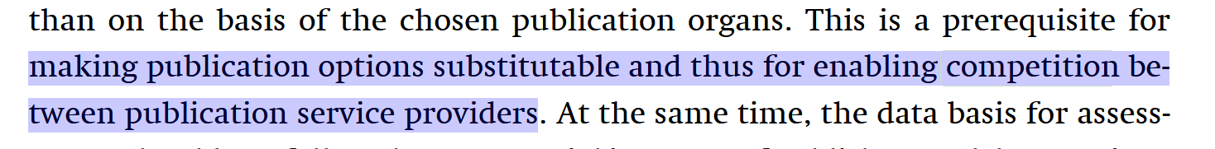
How to get there?

Slide 39
Substitutability: Tender processes

Slide 40
Substitutability: Tender processes

Slide 41
Incentives I: Procurement Rules
Current journal payments for content allowed only via “single source exemption”
Publishing services cannot be covered by this exemption and must be awarded by tender/bidding:
Open Research Europe
Hardware, Software, Services

Slide 42
How to get there?

Slide 43
How to get there?
“From the point of view of functional interchangeability, two different publications could hardly be regarded as substitutable by the end-users, the readers.”

Slide 44
Journal alternatives

Slide 45
Journal alternatives

Slide 46
Journal alternatives

Slide 47
Tackle RAF root: stop paying for journals
A sustainable scholarly infrastructure:
tomorrow
today
Substitutable Services (-> competition!)
No author facing costs
Journal functionalities can be copied
Cost-neutral solutions for data/code
No individual mandates necessary
No journals, no need to judge journal quality
…
…
…
…
…
…
Side effect: permanent, legal, public access
Potential for reform: US$ 9.56 billion p.a.

Slide 48
A system of interoperable digital research objects
Dynamic, version controlled
Can be searched and text-mined
Near-immediate publication
Different models for post-publication review exist
Contributorship in diverse roles
Open to everyone
Code
Data
Interpretations
Preregistration
Materials
DMP
Review/Quality control

Slide 49
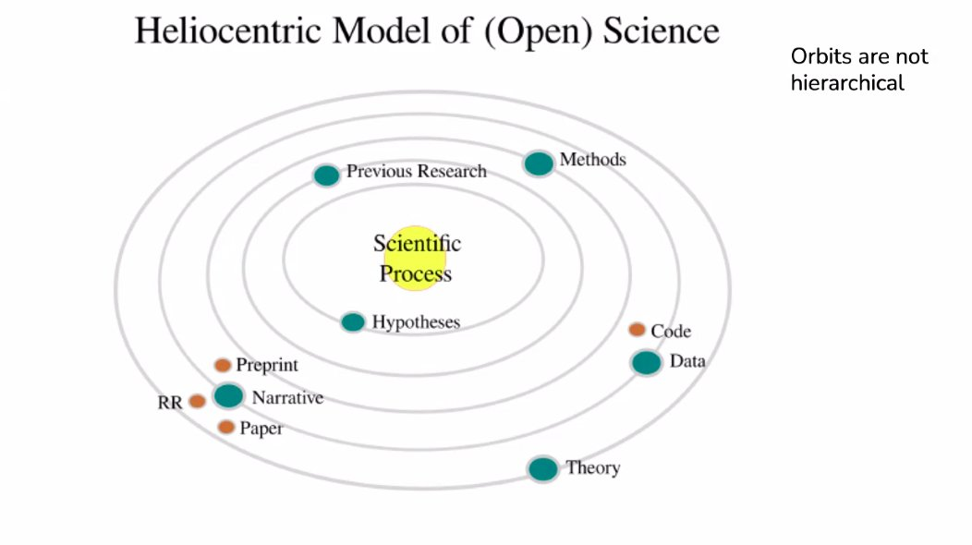
A system of interoperable digital research objects
Dynamic, version controlled
Can be searched and text-mined
Near-immediate publication
Different models for post-publication review exist
Contributorship in diverse roles
Open to everyone
Credit: Mónica González-Márquez, Liberate Science

Slide 50
Incentives II: Eligibility Criteria
https://docs.google.com/document/d/1uG1mcOEkLFFaJm9PDvink_Tabjzsb4aIiNf4pw7LJOg/edit?usp=sharing

Slide 51
Incentivize institutions to replace scholarly journals
Enforce procurement rules once substitutability is established: -> publication payments awarded only via tenders
Funders incentivize institutions to make investments in modern infrastructure via eligibility rules: -> antiquated infrastructure, no funding

